Slide 1
The world without borders. Would it work?
Presented by Md. Hasibul hasan
Id:202324104014

Slide 2
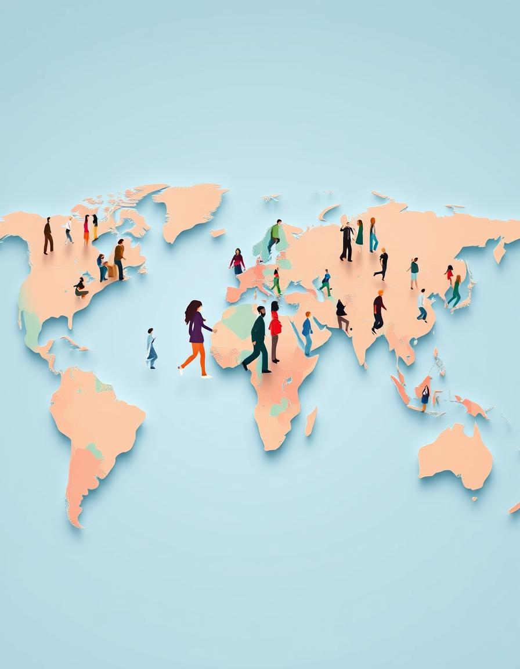
The Concept of Open Borders
Definition:
An open border allows the free movement of people, goods, ideas, and resources without any legal, political, or geographical restrictions.
Example Today:
The Schengen Area is a European region where 29 countries—like France, Germany, Italy, and Spain—have agreed to remove borders between them.[BBC Future, Feb 2023]
This means people can travel from one country to another without needing a passport or visa, just like moving from one city to another.

Slide 3
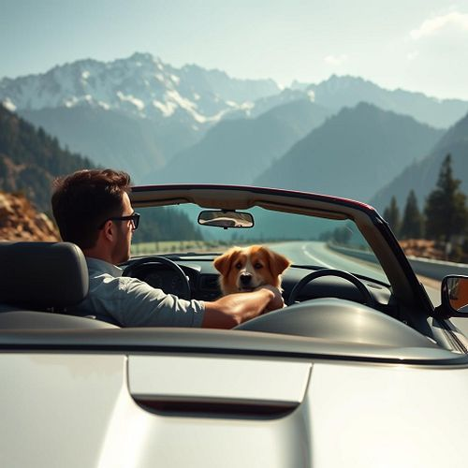
Imagine a World Without Borders
Imagine one morning you wake up and think, "Let’s visit Kashmir today!“
You get ready, get into the car, and drive straight to Kashmir—no passport, visa, or border check.
No conflict over Kashmir between India and Pakistan.
The Rohingya Issue would be solved, too.
They could go back to their home safely.
No need to live as refugees in another land.
Even the world wouldn’t have to witness the genocide and violence in Gaza.

Slide 4

Potential Benefits of a Borderless World
Stronger Global Economy:
Trade would be easier, faster, and cheaper.
More Job Opportunities:
People would find more jobs, and companies would hire better talent.
One Law for All:
One global law and equal rights would apply to everyone.
Faster Help in Emergencies:
During wars or natural disasters, rescue teams and aid would reach people faster.
Better Education Access:
Students would be able to study anywhere without restrictions.

Slide 5
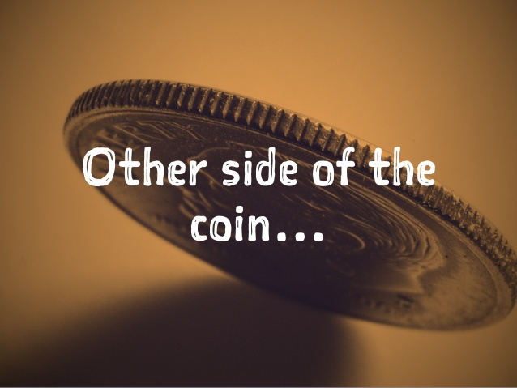
All sounds great, Right?

Slide 6

Let’s Come Back to Reality
Who will take charge of the world then?
Can we trust one person or one organization to make decisions for everyone?
Wouldn’t that person have to be some kind of superhuman—someone who can control the whole world and think equally for all people?
But… What if that person is corrupt or biased?
I’m afraid then, even peaceful countries might end up in the same terrible situation as Gaza is today.

Slide 7
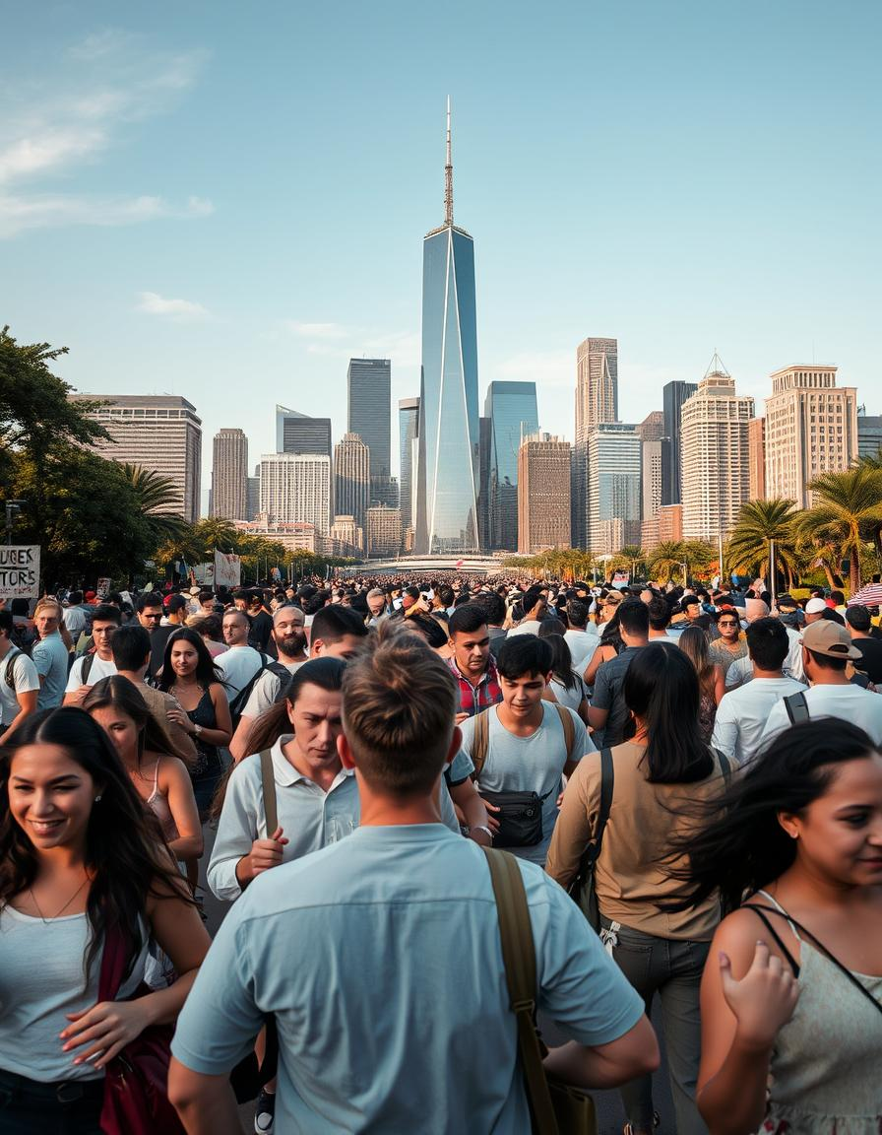
Major Drawbacks of a Borderless World
Security Risks:
It may become harder to stop crime, terrorism, or disease outbreaks.
Cultural Erosion:
Local traditions and languages may slowly disappear.
Loss of National Identity:
People might feel disconnected from their roots, values, and heritage.
Unbalanced Migration:
People may rush to rich countries, leaving poor countries like ours behind.
More Conflicts:
Different cultures living together would cause more conflicts.

Slide 8
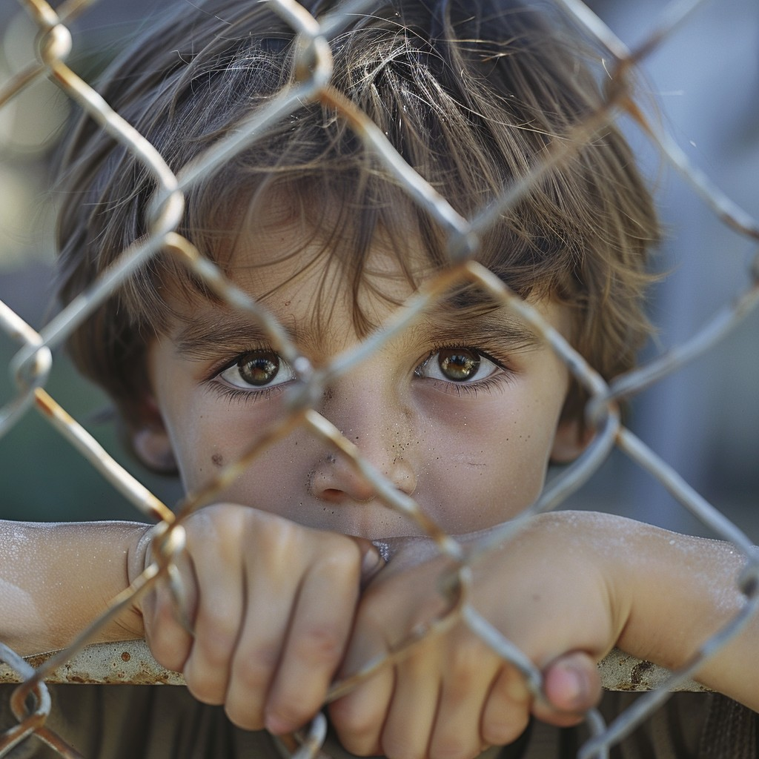
Conclusion
At the end,
“Human nature is the real border.”
….Even if we somehow succeed to create a world without borders, people may still divide themselves into different communities -- based on their religion, language, culture or personal beliefs.
Borders on maps can be removed… But the borders in our hearts may take much longer to erase.

Slide 9
Thank You

